Slide 1
Zelera Deck
Your shop, now in every customer's pocket

Slide 2
Introduction
Zelera Deck modernizes small shops with a simple mobile storefront that drives real sales.
*Launch your digital shop in minutes* and connect directly with customers via WhatsApp for faster orders and personal service.

Slide 3
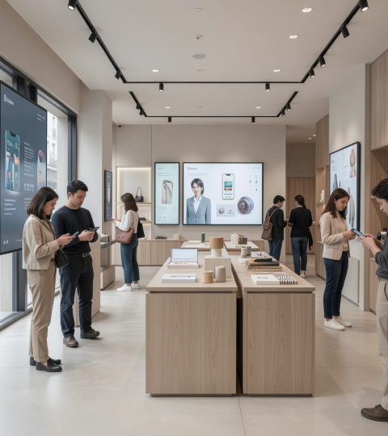
02
Store Digitization

Slide 4
Mobile-first storefront
Create a beautiful, responsive shop optimized for phones so customers browse anytime, anywhere.
Share your shop link on social media to boost visibility and footfall. Mobile-first experience = more conversions.

Slide 5
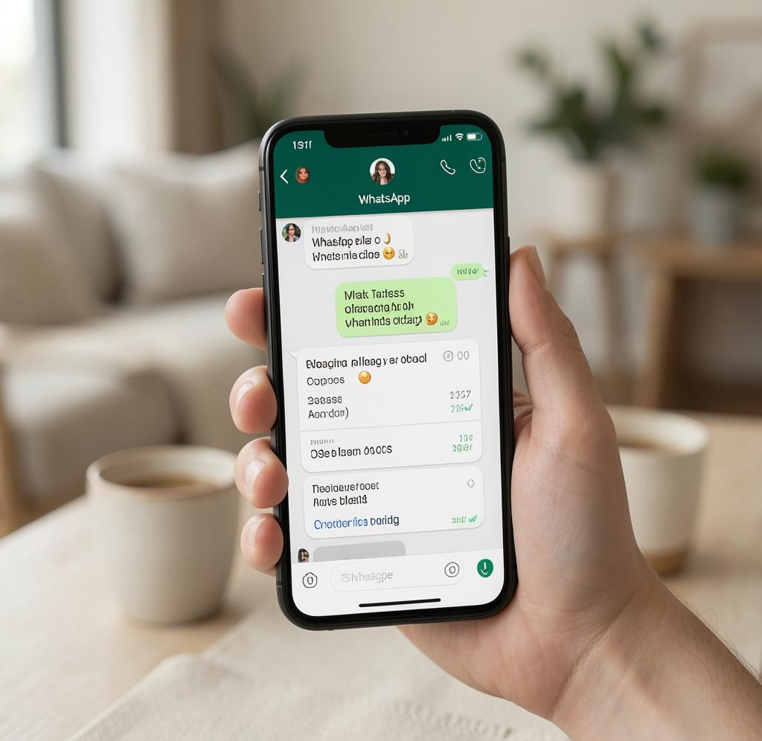
WhatsApp ordering
Customers browse and place orders directly through WhatsApp, keeping interactions personal and immediate.
No cart friction—just messages that turn into sales. Direct orders mean faster confirmation and happier customers.

Slide 6
No technical skills
If you can use WhatsApp or Facebook, you can run your store. No coding, no tech teams required.
Manage items, prices, and availability in seconds from your phone.

Slide 7

03
Pain Points

Slide 8
Cost of websites
Traditional sites cost thousands upfront plus recurring fees and hidden charges.
Zelera Deck offers affordable plans so you modernize without breaking the bank.

Slide 9
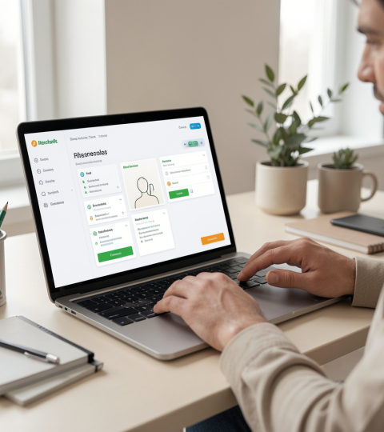
Technical complexity
Complicated platforms need specialists and time to manage.
With Zelera Deck, setup and updates are intuitive—spend minutes, not hours, keeping your shop current.

Slide 10
Slow updates
Updating traditional sites is slow, causing missed sales and customer frustration.
With manual workflows, adding products or stock changes can take hours or days—lose momentum and trust.

Slide 11

03
Zelera Solution

Slide 12
Easy dashboard controls
Manage inventory, prices, and categories from a clear mobile dashboard in seconds.
One-click status updates keep customers informed and prevent disappointment. Fast updates boost reliability.

Slide 13
Direct customer chat
Customers order via WhatsApp for instant, personal conversations that convert quickly.
Keep relationships strong with direct messages and faster confirmations. Personal selling, modernized.

Slide 14

0% commission
Keep every rupee you earn—Zelera Deck charges no commission on sales.
Pay only a simple subscription for full control and higher margins. Full profit retention.

Slide 15
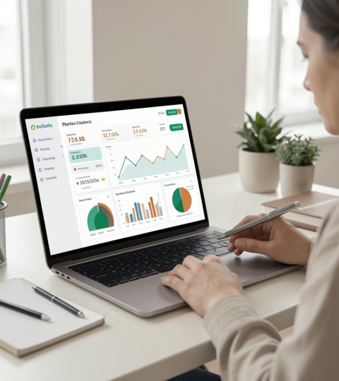
04
Pricing & Growth

Slide 16
Launch offer details
Special launch: ₹1,599 for the first 3 months to get your shop live and visible fast.
Low-risk entry to test digital sales and start growing your customer base immediately.

Slide 17
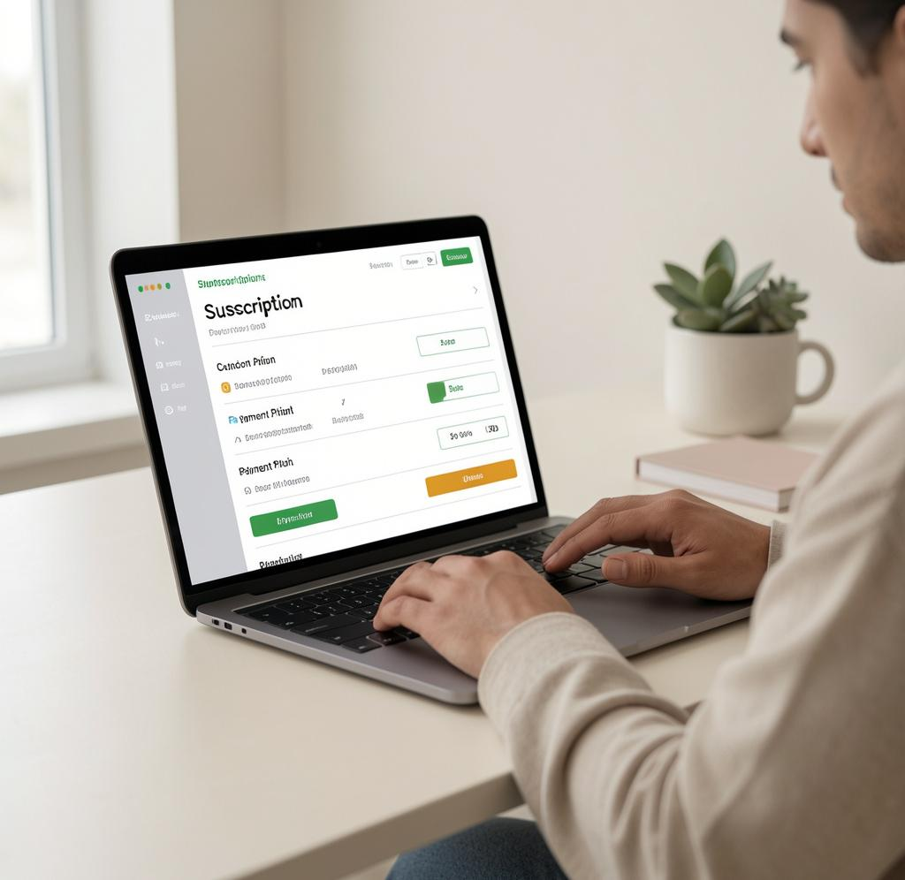
Ongoing plan price
After launch, continue for just ₹699/month to maintain your digital storefront and updates.
Affordable pricing that scales with your business, keeping costs predictable and simple.

Slide 18
Share & promote
Use your custom shop link across Instagram, Facebook, and WhatsApp statuses to reach more buyers.
Simple sharing turns followers into customers—amplify visibility with minimal effort.

Slide 19
Conclusions
Zelera Deck makes digitization simple, affordable, and profitable for local shops.
Launch quickly, keep full profits, and convert customers with direct WhatsApp orders—modern retail without the tech hassle.

Slide 20
Thanks!
Do you have any questions?
youremail@freepik.com
+34 654 321 432
yourwebsite.com
Please keep this slide for attribution

